Slide 1
CC-306 Software Development project-1

Slide 2
Hospital
Management system
(IPD)

Slide 3
Project description :-
In the hospital management system doctor and staff information is stored.
Admin can add doctor and manage staff details. Staff can register patient and store Patient details.
Doctor can manage treatment details of admitted patient and staff will manage payment details.

Slide 4
Tools and technology :-
Front end: PHP With laravel Framework
Back and: My SQL
Server: XAMPP
Editor: Visual studio code
Other tools: MS Power point , MS word, Visio

Slide 5
Brief description of each module :

Slide 6
List of modules :-
Doctor Management
Ward Management
Staff Management
Patient Management
Admission & Discharge Management
Treatment Management
Billing Management

Slide 7
1. Doctor Management :
In this module we will provide facility admin can add doctor.
Doctor can manage own profile.

Slide 8
2. Ward Management :
In this module admin can add different wards , their charges and no of beds available.

Slide 9
3. Staff Management :
Admin can manage details of staff.
Staff can manage profile.

Slide 10
4. Patient Management:
Staff can register patient and store details like patient general information, medical history, family history etc.
Doctor can view details of patient.

Slide 11
5. Admission & Discharge Management:
Staff can admit patient.
Doctor can view admit patient details.
Staff can generate bill and discharge summary.

Slide 12
6. Treatment Management :
Doctor can manage treatment details of admitted patient.
Doctor can manage different test of patient.
Staff can view treatment and give treatment.
Visit of special doctor will be managed by staff.

Slide 13
7. Billing Management:
Staff can manage deposite of patient.
Staff can generate bill using different treatment, medicine , test , doctor visit and other details.

Slide 14
Use case diagram.

Slide 15
Use case diagram of Admin

Slide 17
Use case diagram of Doctor

Slide 19
Use case diagram of Staff

Slide 20
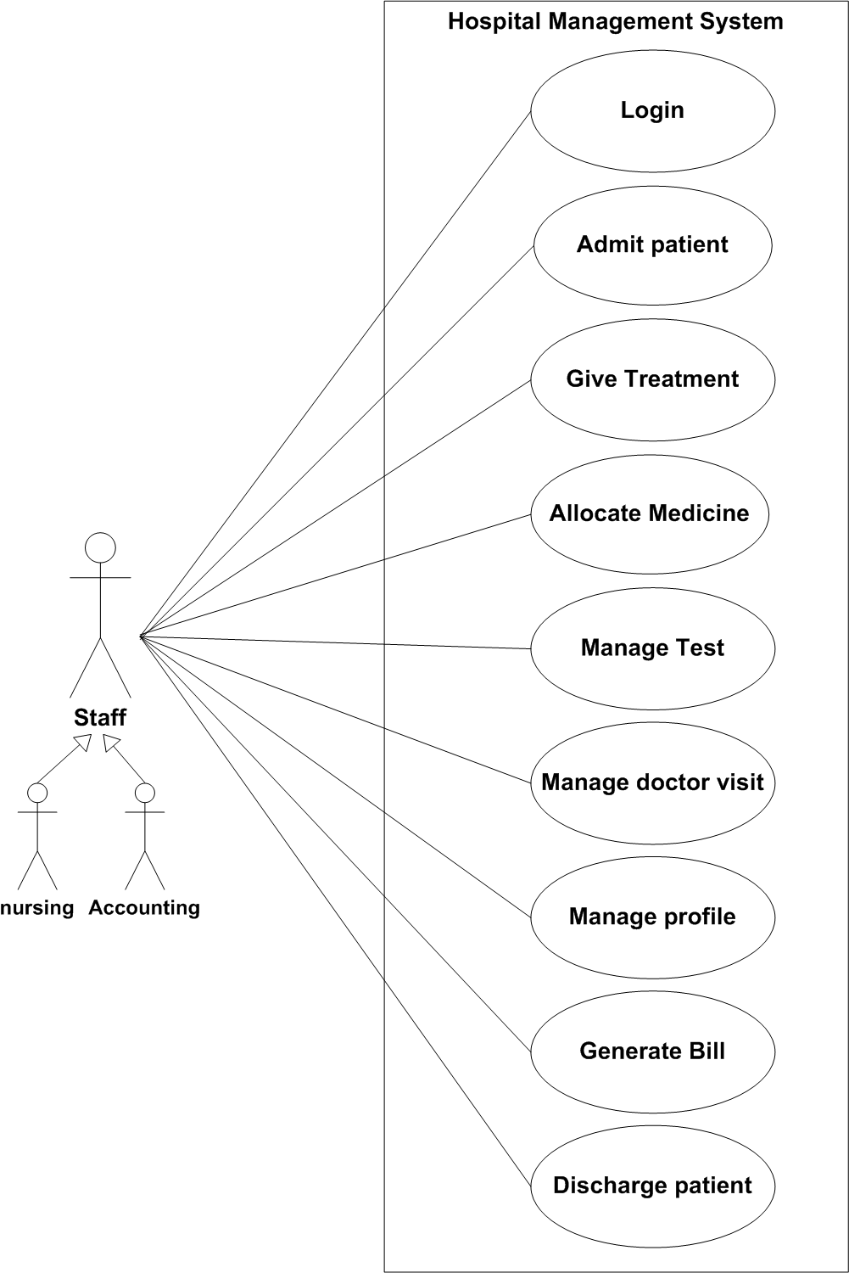

Slide 21
Sequence Diagram

Slide 22
Sequence diagram for
login

Slide 23
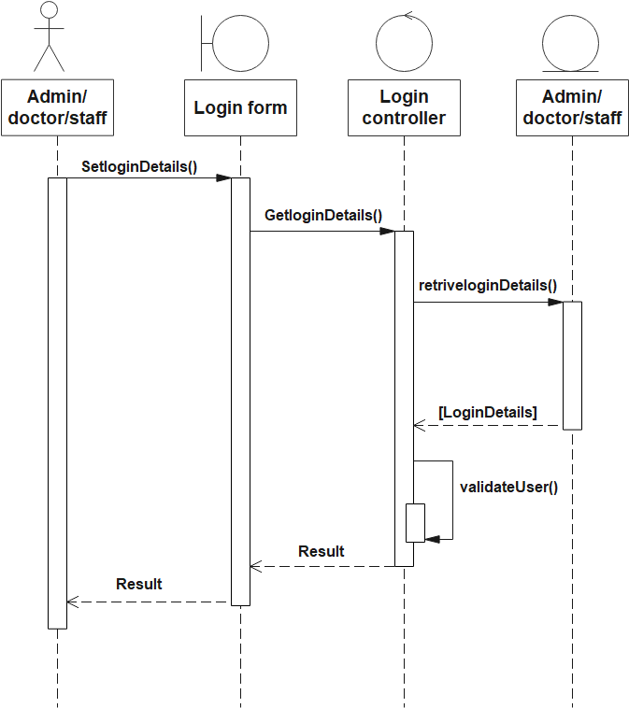

Slide 24
Sequence diagram for Doctor/staff registration

Slide 25
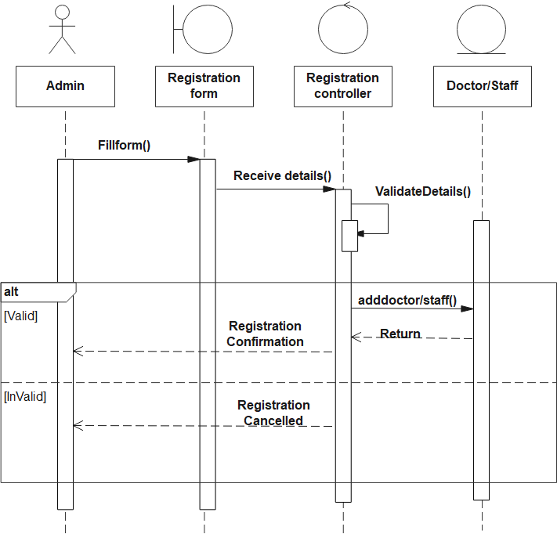

Slide 26
Sequence diagram for Patient registration

Slide 27
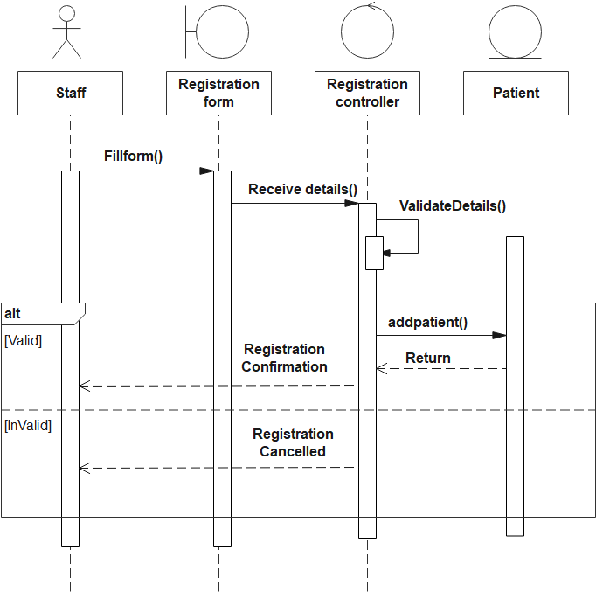

Slide 28
Sequence diagram for patient admission

Slide 29
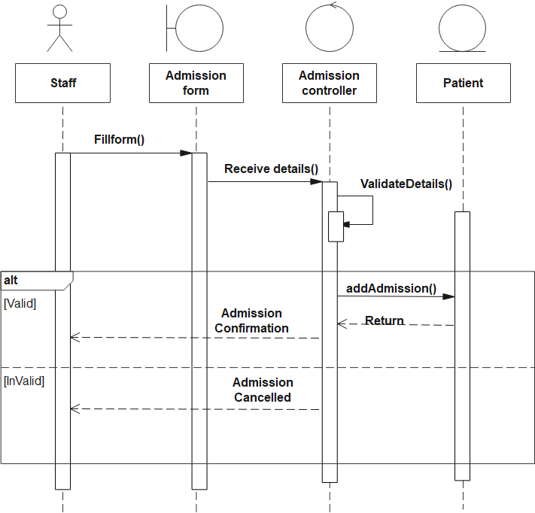

Slide 30
Sequence diagram for Treatment Schedule

Slide 31
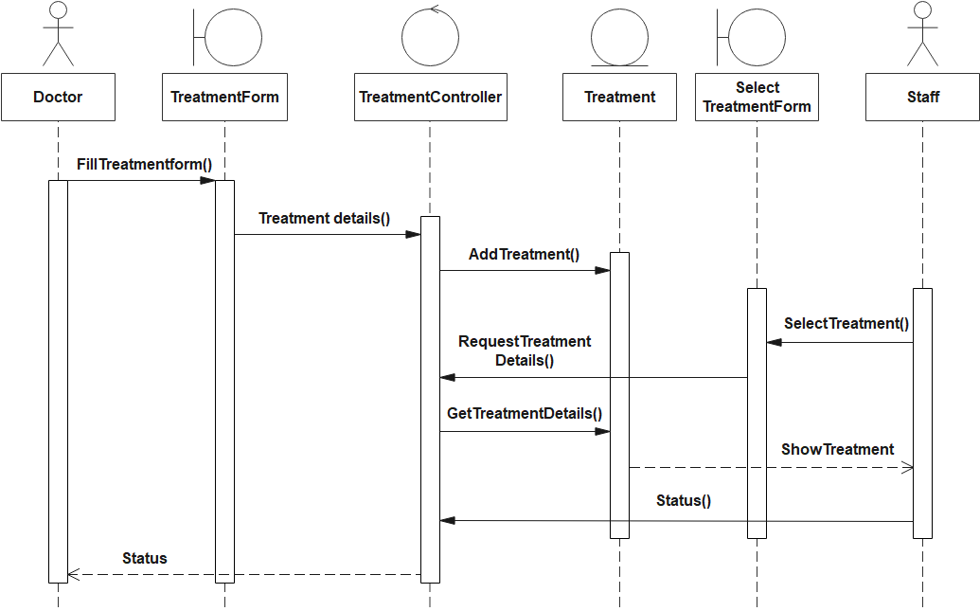

Slide 32
Activity Diagram for Treatment

Slide 33
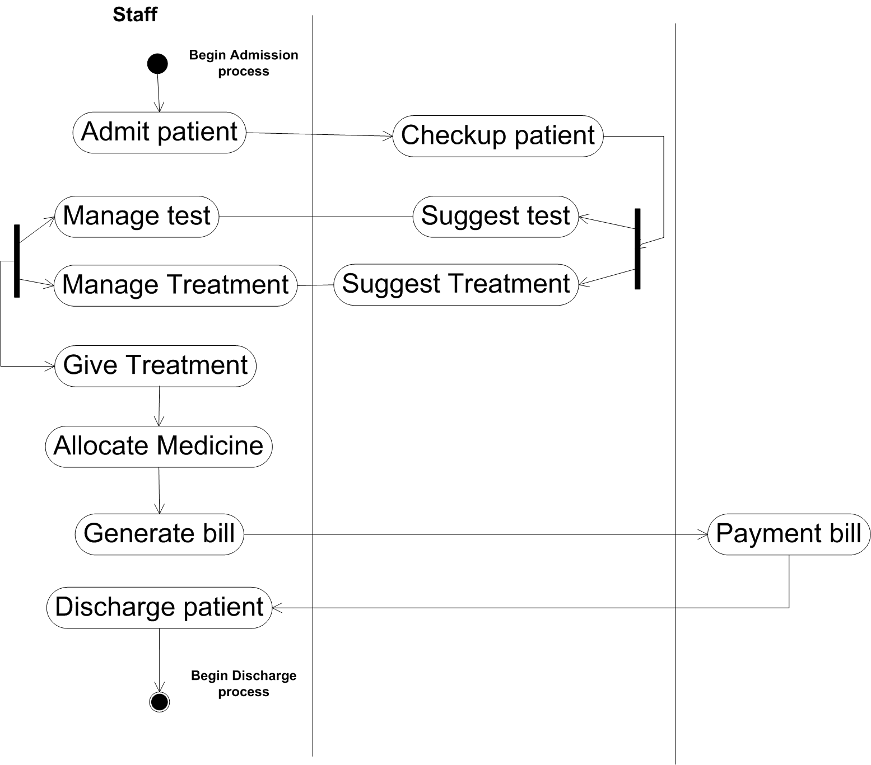

Slide 34
Class Diagram

Slide 35
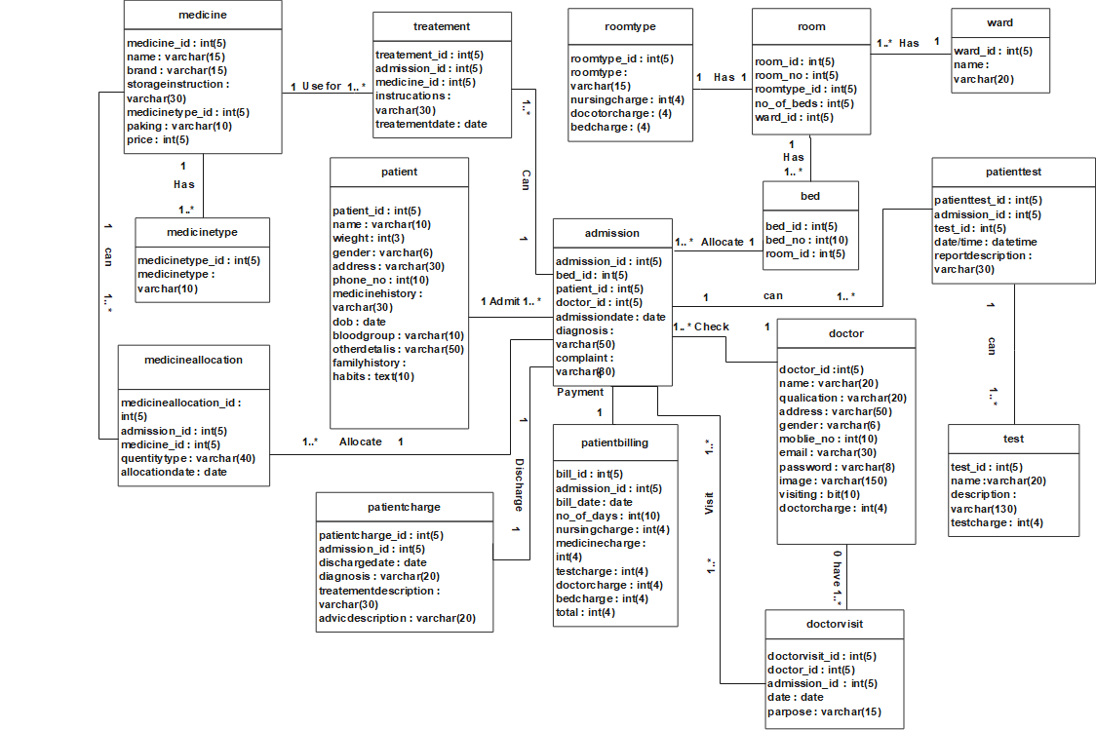

Slide 36
Data dictionary

Slide 37
No | Table name
1 | Admin
2 | Doctor
3 | Ward
4 | Room type
5 | Room
6 | Bed
7 | Staff
8 | Patient
10 | Treatment
11 | Medicine
12 | Medicine type
13 | Test master
14 | Patient test
15 | Medicine allocation
16 | Doctor visit
17 | Patient billing
18 | Patient discharge

Slide 38
1.Table Name : Admin
Primary key : Admin_Id
Foreign Key : -
Description : This table store information about admin.
Field Name | Data Type | Size | Constraint | Description
Admin_id | Int | 5 | Primary key | It store admin_id.
Admin_name | varchar | 10 | Not null | It store admin name.
Password | varchar | 10 | Not null | It store password.

Slide 39
Example : Admin
Admin_id | Admin_name | Password
1 | admin | admin

Slide 40
2.Table Name : Doctor
Primary key : Doctor_Id
Foreign Key : -
Description : This table store information about Doctor
Field Name | Data Type | Size | Constraint | Description
Doctor_Id | Integer | 5 | Primary key | It store doctor Id.
Name | Varchar | 20 | Not null | It store doctor name.
Qualification | Varchar | 20 | Not null | It store qualification.
Address | Varchar | 50 | Not null | It store address.
gender | Varchar | 6 | Not null | It store gender.
Mobile_no | Integer | 10 | Not null | It store contact no.
Email | Varchar | 30 | - | It store email.
Image | Varchar | 100 | Not null | It store image.
password | varchar | 10 | Not null | It store password.
visiting | Bit | 10 | Not null | It store visiting.
Doctorcharge | Integer | 4 | Not null | It store doctorcharge.

Slide 41
Example : doctor
Doc Tor _Id | Name | Qualification | Add ress | gender | Mobile_no | Email | password | visiting | Doctorcharge
1 | Ravi sharma | MD [Medical dermato logy] | Narol | Male | 9725763809 | Ravi@gmail.com | …… | False | 1000
2 | Sana khan | MS [Orthopedic surgeon] | Maninagar | Female | 9107730640 | Sana@gmail.com | …… | True | 2000
3 | Saba khan | MBBS | Isanpur | Female | 4352678900 | Saba@gmail.com | ……. | True | 1000
4 | Uzma shaikh | BPT [physiotherapy] | Ghodasar | Female | 4356789999 | Uzma@gmail.com | ……. | False | 3000
5 | Aazad shaikh | MD [Orthopaedics] | Maninagar | Male | 4325678902 | Aazad@gmail.com | …… | True | 2000

Slide 42
3. Table Name : ward
Primary key : ward_Id
Foreign Key : -
Description : This table store information about ward
Field Name | Data Type | Size | Constraint | Description
Ward_id | Integer | 5 | Primary key | It store ward_id.
Name | Varchar | 10 | Not null | It store name.

Slide 43
Example : ward
Ward_id | Name
1 | Male ward
2 | Female ward
3 | General ward
4 | ICU
5 | Special ward

Slide 44
4. Table Name : Room type
Primary key : Roomtype_Id
Foreign Key : -
Description : This table store information about room
Field Name | Date | Size | Constraint | Description
Roomtype_id | Integer | 5 | Primary Key | It store roomtype_id.
Roomtype | varchar | 15 | Not null | It store Roontype.
Nusringcharge | Integer | 4 | Not null | It store nusring_charge.
doctorcharge | Integer | 4 | Not null | It store doctor_charge.
Bedcharge | Integer | 4 | Not null | It store bed_charge.

Slide 45
Example : Roomtype
Roomtype_id | Roomtype | Nusringcharge | doctorcharge | Bedcharge
1 | Special | 400 | 500 | 200
2 | Semi-special | 300 | 400 | 150
3 | ICU | 800 | 1000 | 500
4 | General | 200 | 300 | 100

Slide 46
5 .Table Name : Room
Primary key : Room_Id
Foreign Key : Roomtype_id , ward_id
Description : This table store information about room
Field Name | Date | Size | Constraint | Description
Room_id | Integer | 5 | Primary key | It store room_id.
Room_no | Integer | 10 | Not null | It store room_no.
Roomtype_id | Integer | 5 | Foreign key | It store roomtype.
No_of_beds | Integer | 10 | Not null | It store no_of_beds.
Ward_id | Integer | 5 | Foreign key | It store ward_id.

Slide 47
Example : Room
Room_id | Room_no | Roomtype_id | No_of_beds | Ward_id
1 | 1 | 1(special) | 1 | 1(Male ward)
2 | 2 | 1(special) | 1 | 2(female ward)
3 | 3 | 2(semi special) | 2 | 2(female ward)
4 | 4 | 4(General) | 5 | 4(General ward)
5 | 5 | 3(ICU) | 1 | 3(ICU)

Slide 48
6. Table Name : Bed
Primary key : Bed_id
Foreign Key : Room_id
Description : This table store information about bed
Field Name | Date | Size | Constraint | Description
Bed_id | Integer | 5 | Primary Key | It store Bed_id.
Bed_no | Integer | 10 | Not null | It store Bed_no.
Room_id | Integer | 5 | Foreign key | It store Room_id.

Slide 49
Example : Bed
Bed_id | Bed_no | Room_id
1 | 1 | 1(Special)
2 | 2 | 2(semi special)
3 | 3 | 2(semi special)
4 | 4 | 3(ICU)
5 | 5 | 4(General)

Slide 50
7.Table Name : Staff
Primary key : Staff_ID
Foreign Key : -
Description : This table store information about staff
Field Name | Data Type | Size | Constraint | Description
Staff_id | Integer | 5 | Primary Key | It Store Staff_Id.
Name | Varchar | 20 | Not null | It store name.
Gender | Varchar | 6 | - | It store gender.
Address | Varchar | 40 | - | It store address.
Email | Varchar | 30 | Not null | It store email.
Password | Varchar | 10 | Not null | It store password.
Designation | Varchar | 10 | Not null | It store designation.
qualification | varchar | 15 | Not null | It store qualification.

Slide 51
Example : staff
Staff _id | Name | Gender | Address | Mobile | Email | Password | Designation | Qualifi cation
1 | Mohit | Male | Narol | 1234567878 | mohit@gmail.com | …… | Nursing | Nursing course
2 | Harsh | - | - | 2345432345 | harsh@gmail.com | …… | Accounting | Telly course
3 | Manvi | Female | Narol | 9867545699 | Manvi@gmail.com | …… | nursing | 12 Pass
4 | Riva | - | Ghodasar | 2350887463 | Riva@gmail.com | …… | Nursing | Nursing course
5 | mansi | Female | - | 8831113255 | mansi@gmail.com | …… | Accounting | 12 pass

Slide 52
8.Table Name : patient
Primary key : patient_id
Foreign Key : -
Description : This table store information about patient.
Field Name | Data Type | Size | Constraint | Description
Patient_id | Integer | 5 | Primary key | It store patient_id.
Name | Varchar | 10 | Not null | It store name.
Weight | Varchar | 10 | Not null | It store weight.
Gender | Varchar | 6 | Not null | It store gender.
Address | Varchar | 30 | Not null | It store address.
Phone | Integer | 10 | - | It store phone.
Medical history | Varchar | 30 | Not null | It store medical history.
Family history | Varchar | 30 | - | It store family history.
DOB | Date | 10 | - | It store DOB.
Blood group | Varchar | 10 | Not null | It store blood group.
Habits | Varchar | 20 | - | It store habits.
Other details | Varcahr | 50 | - | It store other details.

Slide 53
Example : patient
Patient_id | Name | Weight | Gender | Address | Phone | Medical history | Family history | DOB | Blood group | Habits | Other details
1 | Kasu | 35 | Male | Naroda | - | Pneumonia |  | - | A+ | Smoking | food Allergy
2 | Karan | 40 | Male | Narol | 3456458978 | Acidity | BP | - | O- | Drugs | Smell of allergy
3 | Ami | 55 | Female | vastral | 1235743885 | BP | Pneumonia | - | B+ | - | -
4 | parth | 30 | Male | Ghodasar | - | Diabetes | Jaundice | - | O+ | Smoking | food Allergy
5 | sweta | 49 | Female | maninagar | 2387188632 | BP | Astama | - | AB+ | Drinking | -

Slide 54
9.Table Name : Admission
Primary key : Admission_Id
Foreign Key : Bed_id , Patient_id , Doctor_id
Description : This table store information about Admission.
Field Name | Data Type | Size | Constraint | Description
Admission_id | Integer | 5 | Primary key | It store admission_id.
Admission date | date | 10 | Not null | It store Admissiondate
Bed_id | Integer | 5 | Foreign key | It store bed_id.
Patient_id | Integer | 5 | Foreign key | It store patient_id.
Complaint | Varchar | 80 | Not null | It store complaint.
Doctor_id | Integer | 5 | Foreign key | It store doctor_id.
Diagnosis | Varchar | 50 | - | It store diagnosis.

Slide 55
Example : Admission
Admission_id | Admissiondate | Bed_id | Patient_id | Complaint | Doctor_id | Diagnosis
1 | 2021/01/04 | 1 | 1 | Fever, vomiting, weakness, Abdominal cramps. | 1 | Food poisoning
2 | 2021/09/02 | 2 | 1 | Headache, Running nose, High fever , breathlessness. | 2 | Pneumonia
3 | 2021/05/12 | 3 | 3 | Fever, chills, Change skin color. | 2 | Jaundice
4 | 2021/03/11 | 4 | 3 | Patches of dark skin , always feeling hungry & pain in the hands or feet. | 1 | -
5 | 2021/01/12 | 5 | 4 | Pain in chest,neck,arms, back Sleep disturbance. | 2 | Heart Attack.

Slide 56
10.Table Name : Medicinetype
Primary key : Medicinetype_ID
Foreign Key : -
Description : This table store information about medicinetype
Field Name | Data Type | Size | Constraint | Description
Medicine type_id | Integer | 5 | Primary Key | It store medicinetype_id.
Medicinetype | Varchar | 10 | Not null | It store medicinetype.

Slide 57
Example : Medicinetype
Medicinetype_id | Medicinetype
1 | Drop
2 | Tablet
3 | capsule
4 | Injection

Slide 58
11.Table Name : Medicine.
Primary key :Medicine_id.
Foreign Key :MedicineType_id.
Description : This table store information about Medicine.
Field Name | Data Type | Size | Constraint | Description
Medicine_id | Integer | 5 | Primary Key | It Store Medicine_id.
Name | varchar | 20 | Not null | It Store medicine Name.
Brand | varchar | 15 | Not null | It Store medicine Brand.
Storage Instruction | varchar | 20 | Not null | It Store medicine storage instruction.
MedicineType _id | Integer | 5 | Foreign Key | It Store MedicineType_id
Packing | varchar | 10 | Not null | It Store medicine Packing.
Price | Integer | 4 | Not null | It Store medicine Price

Slide 59
Example: Medicine
Medicine_id | Name | Brand | Storage Instruction | Medicine Type_id | Pack ing | Price
1 | Metacin | Cadila | Room tamperature | 1 | 15ml | 33
2 | Paracitamol 500Mg | Sun pharm | Room tamperature | 2 | 10 | 75
3 | Cephalexin 250Mg | Cefalix | Cool&dry place | 3 | 6 | 65
4 | Ceftriaxone | Delex pharm | Room tamperature | 4 | 1GM | 56
5 | CoTtrimoxazole 400mg | Bactomed | Cool&dry place | 5 | 15 | 500

Slide 60
12.Table Name : Medicine allocation
Primary key : Medicineallocation_ID
Foreign Key : Admission_id, Medicine_id
Description : This table store information about Medicine allocation.
Field Name | Data Type | Size | Constraint | Description
Medicine allocation_id | Integer | 5 | Primary Key | It Store medicine allocation id.
Admission_id | Integer | 10 | Foreign Key | It store admission_id.
Medicine_id | Integer | 20 | Foreign Key | It store medicine_id.
Quantity | Varchar | 40 | Not null | It store quantity.
Allocationdate | Date | 10 | Not null | It store Allocation_date.

Slide 61
Example: Medicine allocation
medicine allocation _id | Admission _id | Medicine _id | Quantity | Allocation Date
1 | 1 | 1 | 1[Bottle] | 2021/01/04
2 | 1 | 2 | 10[Tablet] | 2021/01/04
3 | 3 | 3 | 6[capsule] | 2021/05/12
4 | 3 | 4 | 5[Injection] | 2021/05/12
5 | 4 | 2 | 15[Tablet] | 2021/01/12

Slide 62
13.Table Name : Treatment
Primary key : Treatment_id
Foreign Key : Admission_id, Medicine_id.
Description : This table store information about Treatment
Field Name | Data Type | Size | Constraint | Description
Treatment_ id | Integer | 5 | Primary Key | It Store Treatement_id.
Admission_ id | Integer | 5 | Foreign key | It Store Admission_id.
Medicine_id | Integer | 10 | Foreign key | It Store Medicine_id.
Instructions | Varchar | 30 | Not null | It store instruction.
Treatment Date | Date | 10 | Not null | It Store treatment date.

Slide 63
Example : Treatment
Treatmen_id | Admission_id | Medicine_id | instructions | Treatmentdate
1 | 1 | 1 | 1-0-0 | 2021/01/04
2 | 1 | 2 | 1-1-1 with milk | 2021/01/04
3 | 3 | 3 | 1-1-0 | 2021/05/12
4 | 3 | 4 | 1-1-1 | 2021/05/12
5 | 4 | 2 | 1-0-1 With milk | 2021/01/12

Slide 64
14.Table Name : Test
Primary key : Test_id
Foreign Key :-
Description : This table store information about test master
Field Name | Data Type | Size | Constraint | Description
Test_id | Integer | 5 | Primary Key | It store Test_id.
Name | Integer | 30 | Not null | It store name.
Description | Varchar | 130 | Not null | It store description.
Testcharge | Integer | 4 | Not null | It store test_charge.

Slide 65
Example : Test
Test _id | Name | Description | Testcharge
1 | Diabetes test | This test measure your blood sugar level. | 70
2 | Sonography test | An Sonography test is a medical test that uses high –frequency sound waves to capture live images from the inside of your body. | 600
3 | ECG | ECG test that can used to check your heart’s rhythm and electrical activity | 255
4 | Hemoglobin blood test | This test measure the amount of hemoglobin in your blood. | 199
5 | Tuberculosis skin test | This test to see if you have ever been exposed to tuberculosis. | 500

Slide 66
15.Table Name : Patient test
Primary key : Patienttest_ID
Foreign Key : Admission_id, Test_id
Description : This table store information about patient test
Field Name | Data Type | Size | Constraint | Description
Patienttest_ Id | Integer | 5 | Primary Key | It store patient_id.
Admission_id | Integer | 10 | Foreign key | It store Admission_id.
Test_id | Integer | 5 | Foreign key | It store Test_id.
Date/time | DateTime | 50 | Not null | It store datetime.
Report description | Varchar | 30 | Not null | It store report description.

Slide 67
Example : patient test
Patienttest_ Id | Admission_id | Test_id | Date/time | Report description
1 | 1 | 1 | 2021/01/04 11:00AM | Suger level is 225 high.
2 | 3 | 2 | 2021/05/12 11:30AM | Normal
3 | 3 | 3 | 2021/05/12 12:00PM | Normal
4 | 4 | 4 | 2021/01/12 11:00AM | Normal 12.O to 15.5
5 | 4 | 5 | 2021/01/12 12:00PM | Negative

Slide 68
16.Table Name : Doctor visit
Primary key :Doctorvisit_id
Foreign Key :Admission_id, Doctor_id
Description : This table store information about doctor visit.
Field Name | Data Type | Size | Constraint | Description
Doctorvisit_id | Integer | 5 | Primary key | It store doctorvisit_id.
Doctor_id | Integer | 5 | Foreign key | It store doctor_id.
Admission_id | Integer | 5 | Foreign key | It store admission_id.
Date | Date | 10 | Not null | It store date.
Purpose | Varchar | 20 | Not null | It store purpose.

Slide 69
Example: Doctor visit
Doctorvisit_id | Doctor_id | Admission_id | Date | Purpose
1 | 1 | 1 | 2021/01/04 | Infection
2 | 1 | 2 | 2021/09/02 | Skin allergy
3 | 2 | 3 | 2021/05/12 | Back problems
4 | 2 | 3 | 2021/03/11 | Cholesterol problems
5 | 3 | 4 | 2021/01/12 | Medicine allergy

Slide 70
17.Table Name : PatientDischarge
Primary key :PatientDischarge_id
Foreign Key :Admission_id
Description : This table store information about Patient Discharge.
Field Name | Data Type | Size | Constraint | Description
PatientDischarge_id | Integer | 5 | Primary Key | It Store PatientDischarge_id.
Admission_id | Integer | 5 | Foreign Key | It Store Admission_id.
Dischargedate | Date | 10 | Not null | It Store Dischargedate.
Diagnosis | Varchar | 20 | Not null | It Store Diagnosis.
TreatmentDescription | Varchar | 110 | Not null | It Store TreatmentDescription.
Advice Description | Varchar | 100 | Not null | It Store Advice Description.

Slide 71
Example: PatientDischaege
PatientDischarge_id | Admission_id | Dischargedate | Diagnosis | TreatmentDescription | Advice Description
1 | 1 | 2021/01/11 | Food poisoning | Supportive care( improvement, oral rehydration solution(ORS)) Medications. | Eat Fruit and vegetable, don’t eat junk food.
2 | 1 | 2021/09/15 | Pneumonia | Medications(antibiotics and penicillin)supportive care (oxygen therapy, oral rehydration therapy and IV fluids) | Eat green vegetables , fruit & fish.
3 | 3 | 2021/05/25 | Jaundice | Suggest Rest. | Drink at least eight glasses of fluids per day, You have to add milk in your routine.
4 | 3 | 2021/03/22 | Diabetes mellitus | Diet, exercise, medication and insulin therapy. | Healthy diet, exercising and maintaining a body weight.taking medicine if prescribed.
5 | 4 | 2021/01/24 | Heart Attack. | Supportive cagre , medications, medical procedure, therapies, surgery(bypass surgery) | Don’t smoke, don’t drink alcohol.

Slide 72
18.Table Name : Patient Billing.
Primary key :Bill_id
Foreign Key :Admission_id.
Description : This table store information about Patient Billing
Field Name | DataType | Size | Constraint | Description
Bill_id | Integer | 5 | Primary Key | It store Bill_id.
Admission_id | Integer | 5 | Foreign Key | It store Admission_id.
Billdate | date | 10 | Not null | It store Billdate.
No_of_days | Integer | 10 | Not null | It store No_of_days.
Bedcharge | Integer | 4 | Not null | It store Roomcharge.
Doctorcharge | Integer | 4 | Not null | It store Doctorcharge.
Nursingcharge | Integer | 4 | Not null | It store Nursingcharge.
Medicinecharge | Integer | 4 | Not null | It store Medicinecharge.
Testcharge | Integer | 4 | - | It store Testcharge.
Doctorvisitcharge | Integer | 4 | - | It store Doctorvisitcharge.
Total | Integer | 4 | Not null | It store Total.

Slide 73
Example: Patient Billing.
Bill_id | Admission_id | Billdate | No_of_ days | Bedcharge | Doctorcharge | Nursingcharge | Medicinecharge | Test charge | Doctor Visit charge | Total
1 | 1 | 2021/01/11 | 7 | 1,400 | 3,500 | 2,800 | 400 | 70 | 3,000 | 11,170
2 | 2 | 2021/09/15 | 13 | 1,950 | 5,200 | 3,900 | 300 | - | 2,000 | 13,350
3 | 3 | 2021/05/25 | 13 | 6,500 | 13,000 | 10,400 | 300 | 255 | - | 30,455
4 | 4 | 2021/03/22 | 11 | 1,100 | 3,300 | 2,200 | 500 | - | 1000 | 8,100
5 | 5 | 2021/01/24 | 12 | 1,100 | 3,300 | 2,200 | 200 | 500 | - | 7,300

Slide 74
Thank you.

